Slide 1
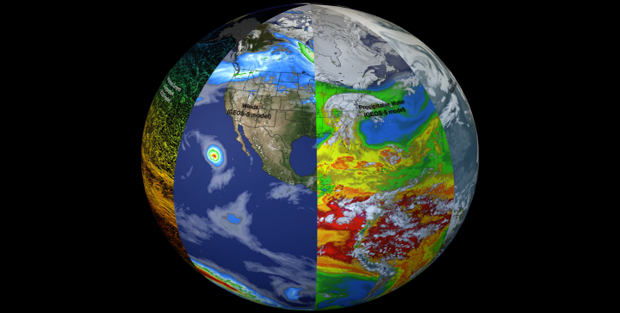
Climate data and models
EDSML MSc – Imperial College London – Environmental data
Yves Plancherel - https://www.linkedin.com/in/yves-plancherel/
https://svs.gsfc.nasa.gov/30701

Slide 2
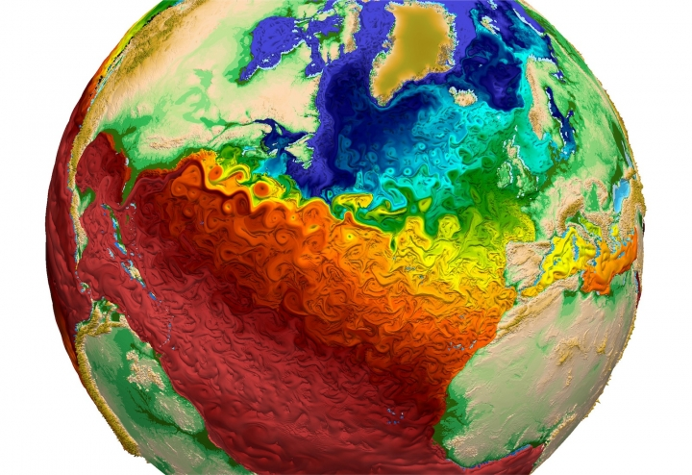
Why discuss climate data and climate models?
Growing/important field – with likely career opportunities
Great playground to deliver learning objectives
Learning objectives of the Environmental Data module
1. Understand common data format and database structures specific to representative fields of environmental science
2. Demonstrate technical competency in handling common data types routinely encountered in the environmental sciences and identify relevant open-source data repositories
3. Identify and design suitable data analysis strategies that consider data types, data distribution constraints, strength, benefits and limitations of statistical and modelling tools and environmental dynamics.
4. Understand the limitation of available data and data analysis products. Understand sources of errors and demonstrate ability to comprehensively characterize uncertainties and interpret results in the context of these uncertainties, including measurement errors, environmental uncertainties as well as errors stemming from the analytical procedure itself (e.g. calibration of analysis using synthetic data/models).

Slide 3
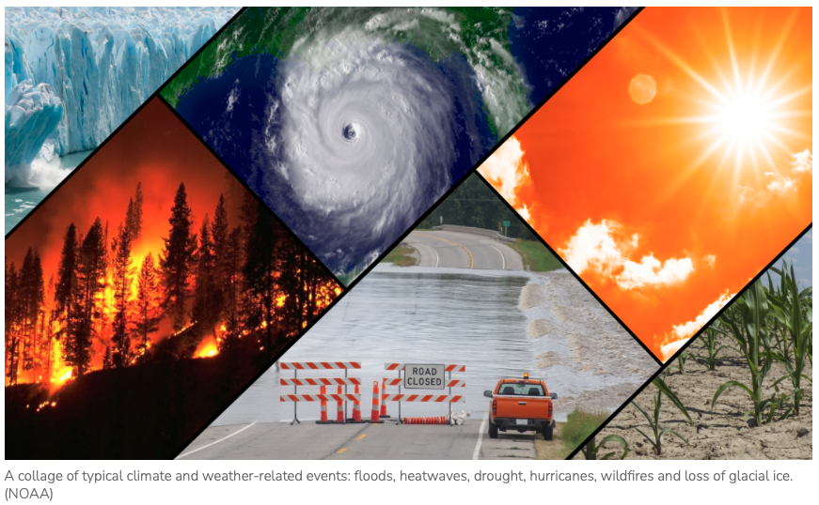
Using climate models: quantification/forecasting
(impacts, adaptation, mitigation)
https://www.noaa.gov/education/resource-collections/climate/climate-change-impacts

Slide 4
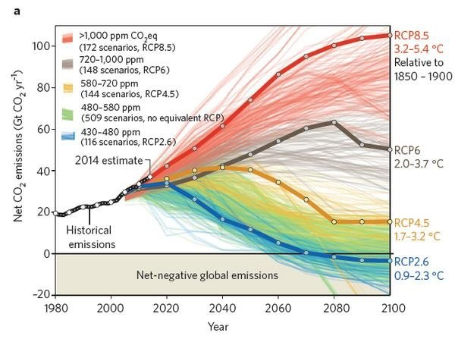
Using climate models: design scenarios (explore policy, technology options)

Slide 5
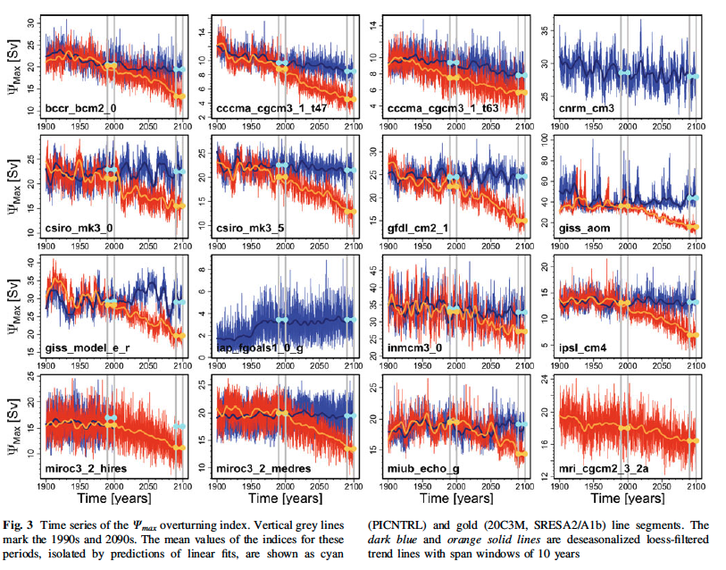
Using climate models: variability (temporal, spatial)
Importance of experimental design!
Control
+
experiment

Slide 6
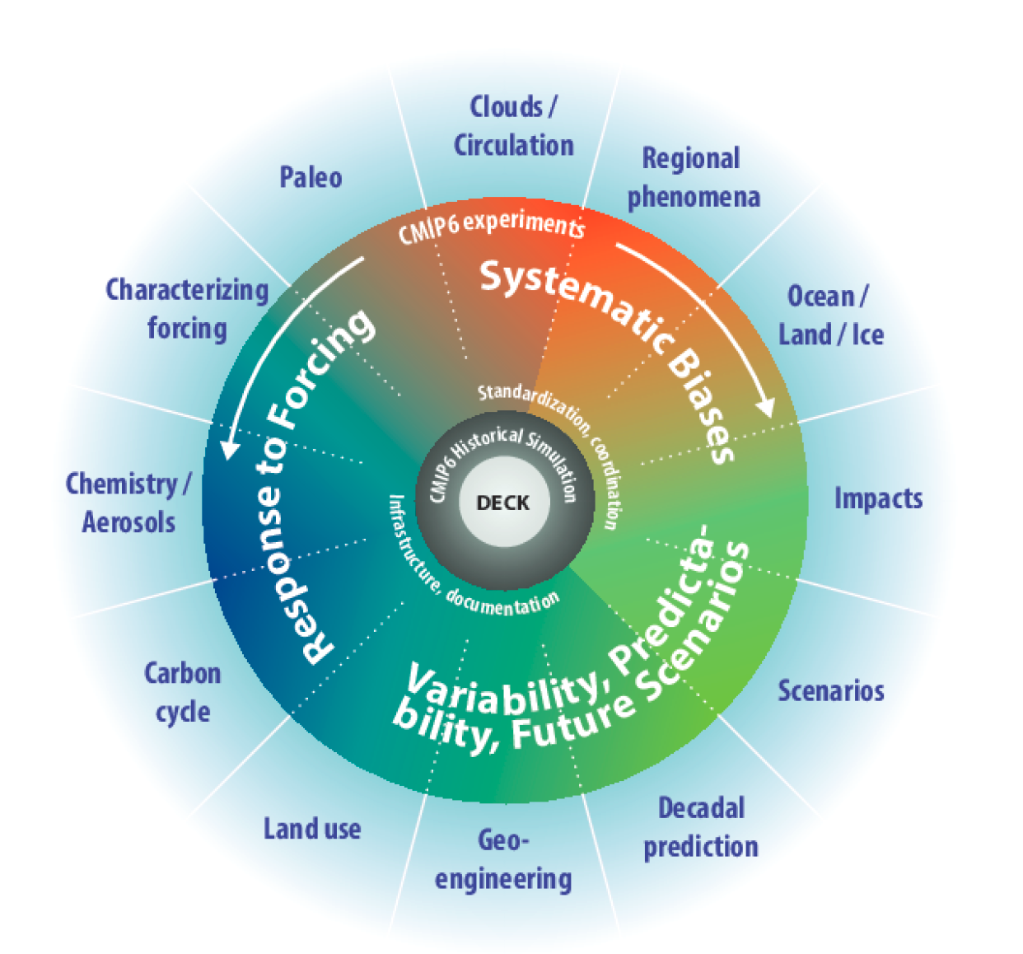
Using climate models: uncertainties and sensitivities
MIP = Model Intercomparison Project
Eyring et al. 2016

Slide 7
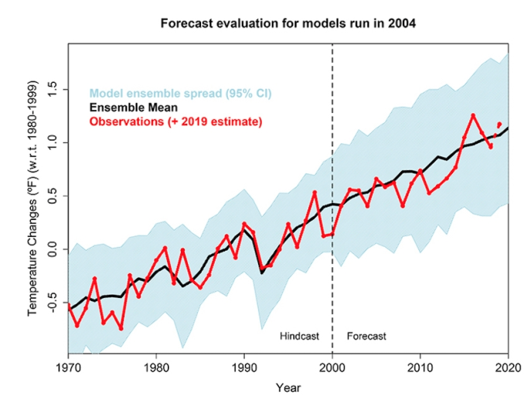
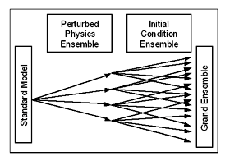
Using climate models: uncertainties and sensitivities
Real world data: we only have one Earth, ONE realization
Different experiments
with many ensembles!
Each one trying to account for sensitivity due to a source of error
Model data: we do what the @#$ we want ☺!
…as long as we can calculate it and analyze it
… and are aware of model flaws!
https://en.wikipedia.org/wiki/Climate_ensemble

Slide 8
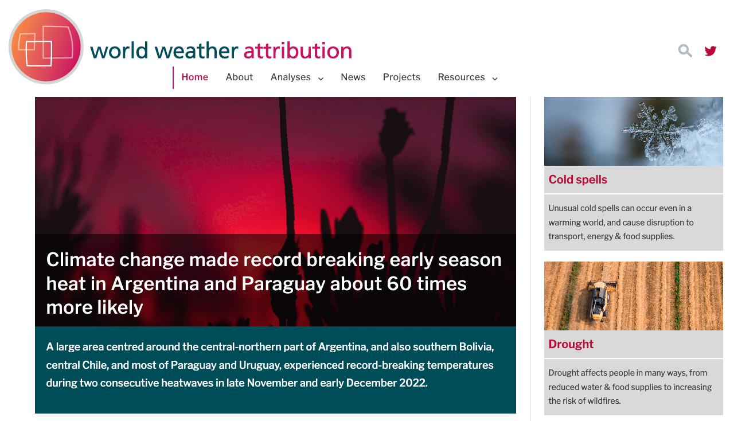
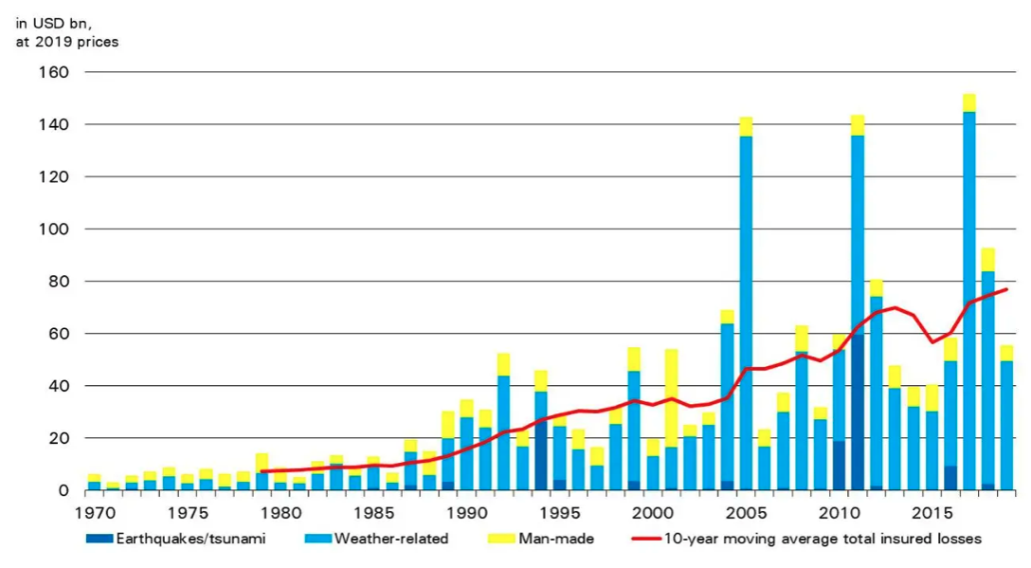
Using climate models: attribution
https://www.worldweatherattribution.org
Whose fault is it?
Who pays for it?
Catastrophe-related insured losses (1970-2019)
https://www.swissre.com/media/news-releases/nr-20191219-global-catastrophes-estimate.html

Slide 9
Climate extremes and climate risk
Magnitude
Frequency
Duration
Spatial extent
What variable?
T, Precipitation, winds, sea level, etc.
Humans
Infrastructures
Agriculture
Biodiversity
Landscape
GDP
Administration
Policy
…

Slide 10
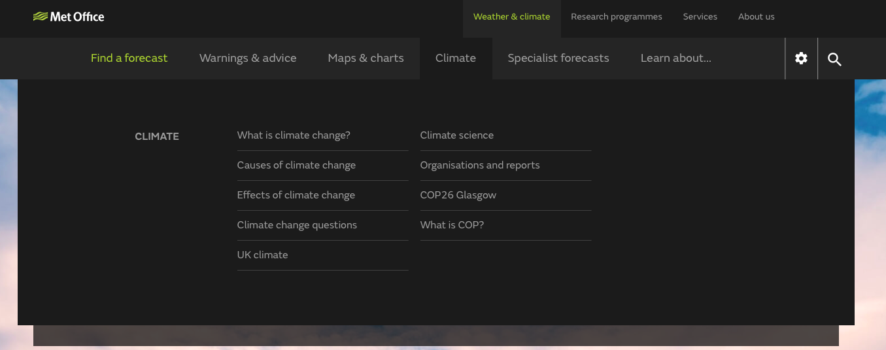
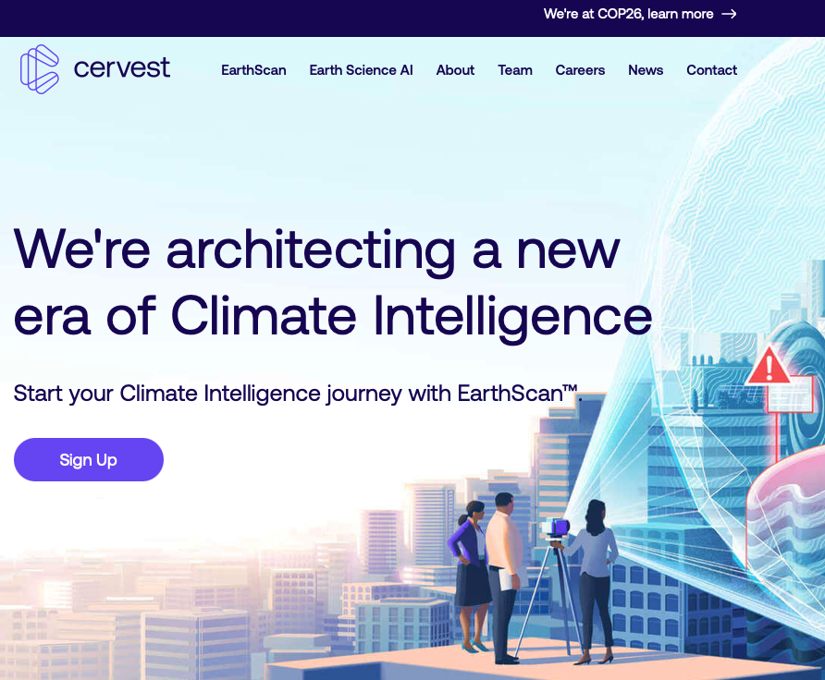
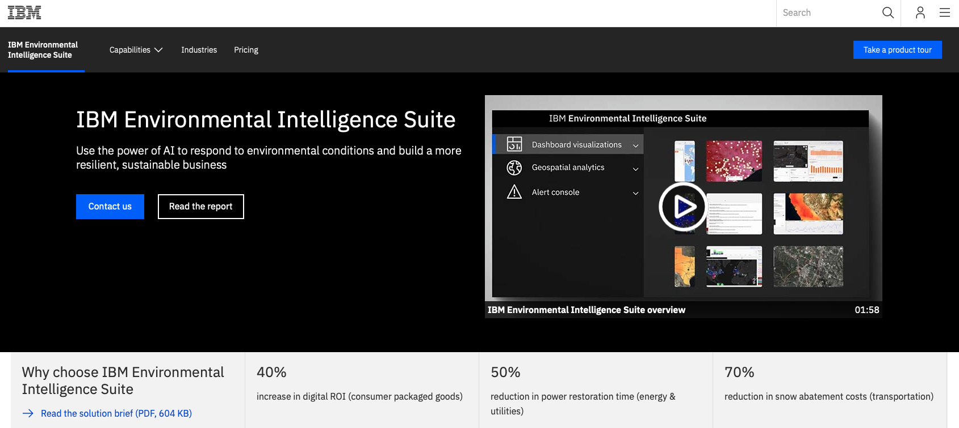
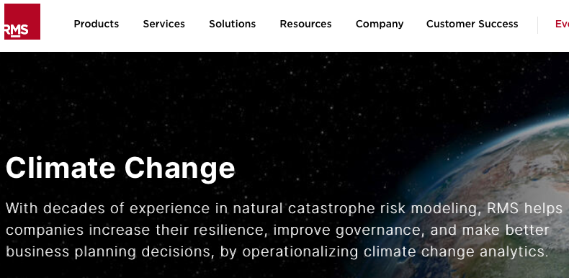
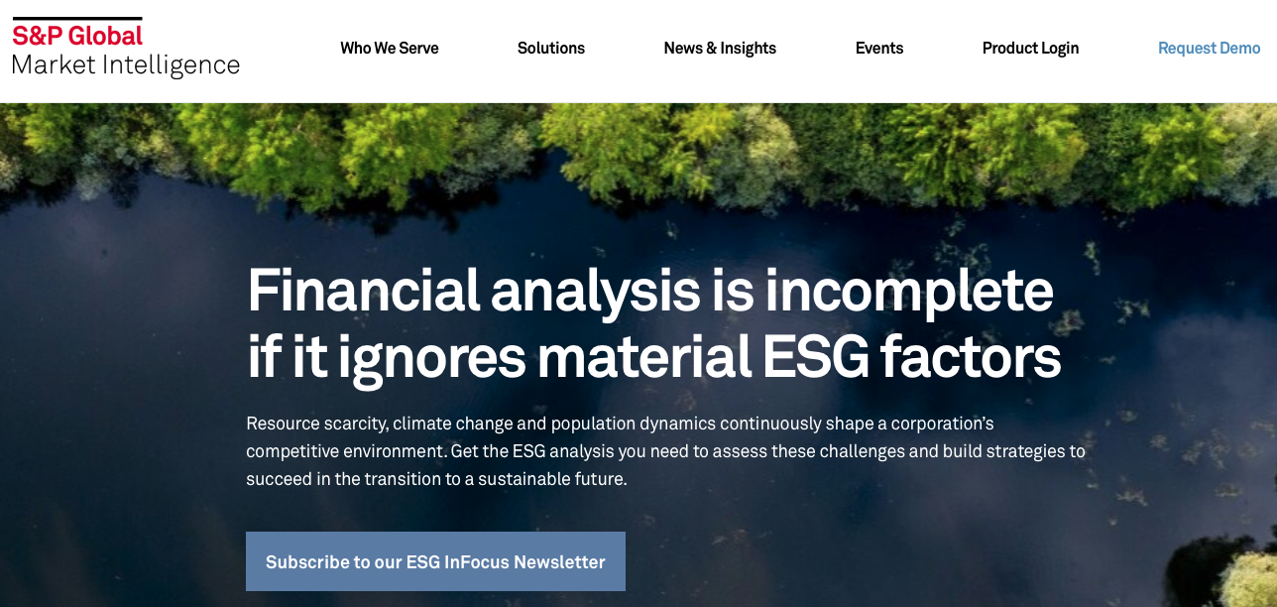
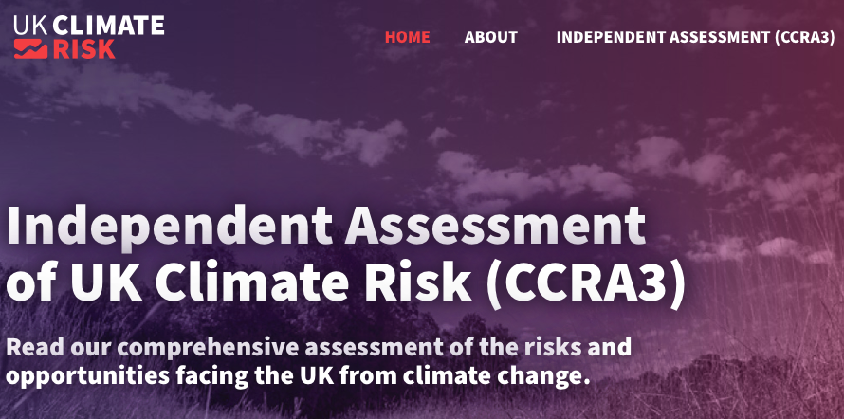
The business (and opportunities) of climate
https://cervest.earth
https://www.metoffice.gov.uk
https://www.rms.com/climate-change
https://www.ibm.com/uk-en/products/environmental-intelligence-suite
https://www.ukclimaterisk.org
https://www.spglobal.com/marketintelligence/en/campaigns/esg-analysis

Slide 11
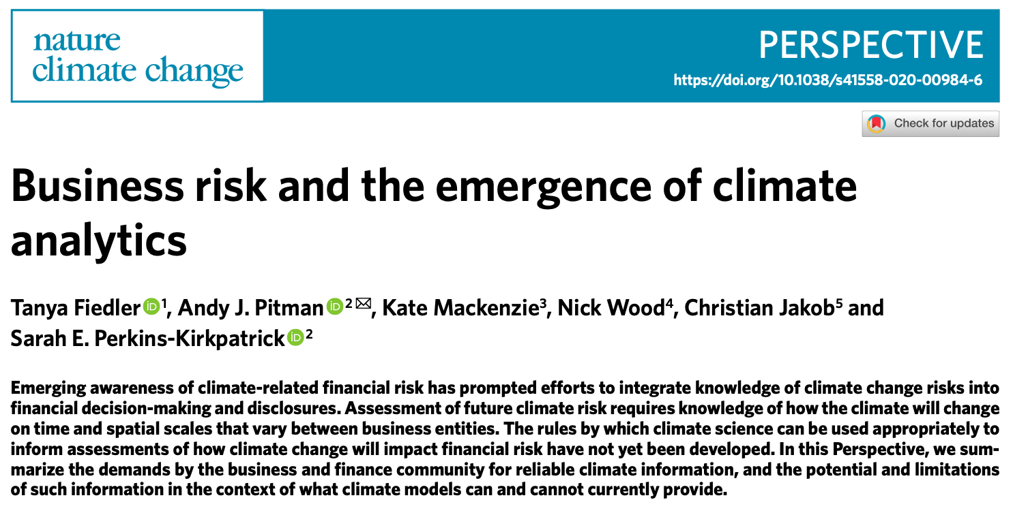
Business risk and climate analytics
… an emerging field! Get involved now – probably lots of good opportunities in that sector!
https://www.nature.com/articles/s41558-020-00984-6

Slide 12
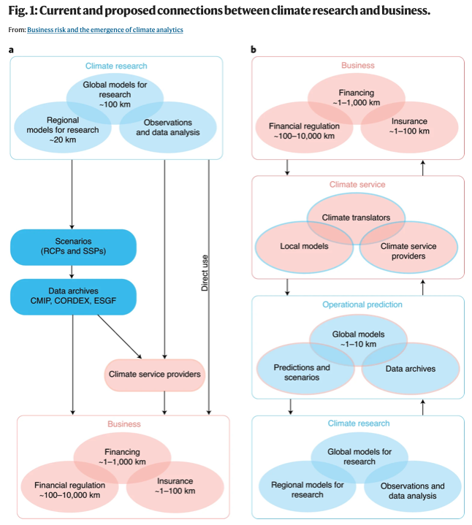
Climate services
Fiedler et al. 2021 advocate for a reorganization of climate science highlighting the need for climate projection to be professionalized as an operational service (b)
i.e. the way the field of climate science works will evolve in the next few years
https://www.nature.com/articles/s41558-020-00984-6

